Slide 1
Flash tool

Slide 2
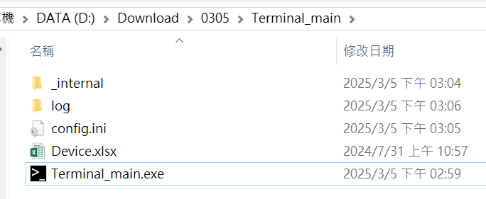
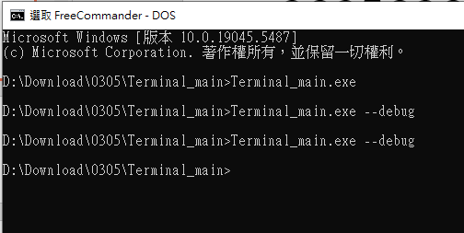
Flash tool in debug mode
-> Debug message
Click Terminal_main.exe to run the flash tool or add –debug to run in the debug mode.

Slide 3
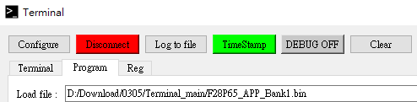
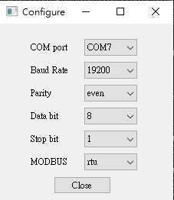

Program step
1
2
Click configure.
Select COM port.
Check COM port is connected and click program page.
Click … to open the bin file.
Click Upgrade
3
4
5

Slide 4
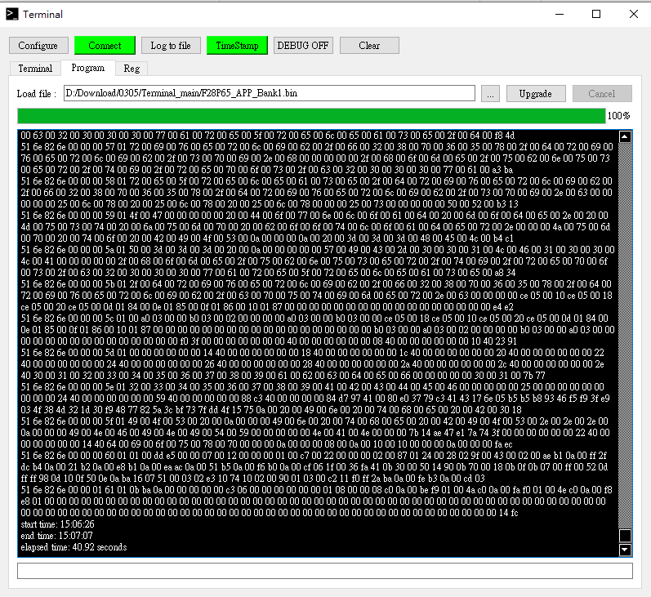

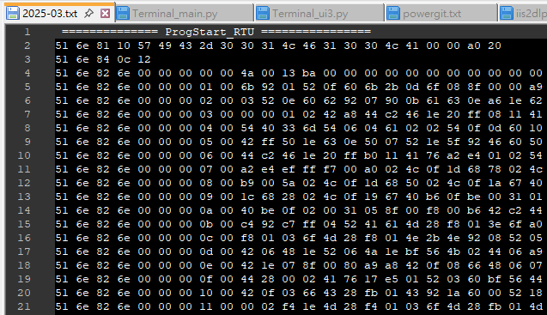
Log
CRC

Slide 5
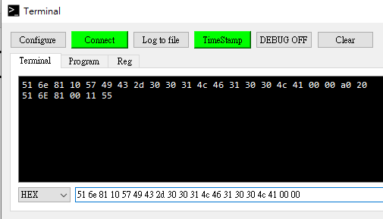
Manual command
1
4
2
3
Go to the Terminal page.
Select HEX mode.
Enter the Modbus command without CRC and press Enter to send it.
Check the response in the output window.

